Slide 1
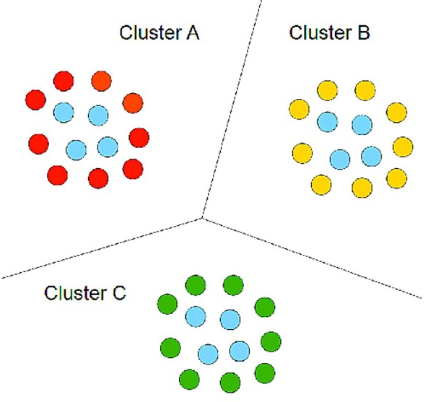
Customer Segmentation using K Means Clustering
Machine Learning Projects

Slide 2

Introduction
Customer Segmentation is the subdivision of a market into discrete customer groups that share similar characteristics. Customer Segmentation can be a powerful means to identify unsatisfied customer needs.
Customer Segmentation is an unsupervised method of targeting the customers in order to increase sales and market goods in a better way
With the help of the algorithms, we can easily visualize the data and can get a segmentation of each customer so that we can target the customers in the better way
Advantages of Customer Segmentation:
Determine appropriate product pricing.
Develop customized marketing campaigns.
Design an optimal distribution strategy.
Choose specific product features for deployment.
Prioritize new product development efforts.

Slide 3
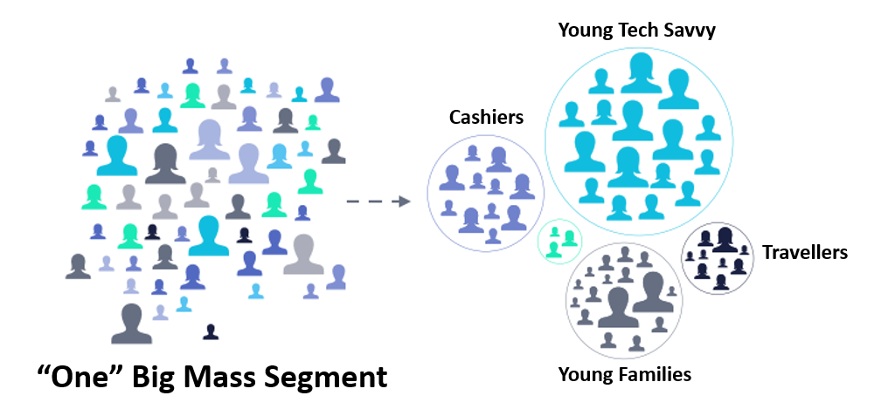
Clustering

Slide 4
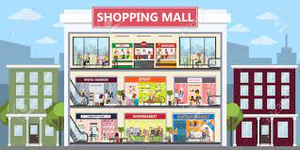
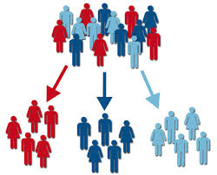



Problem Statement

Slide 5
Work Flow
Getting Customer Data
Data Preprocessing
Data Analysis
Finding Number of Cluster
Importing Cluster Model
Visualiazing Clusters

Slide 6
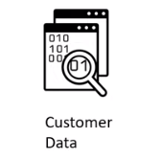
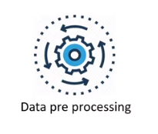
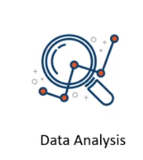
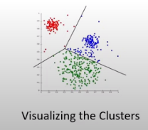
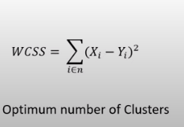
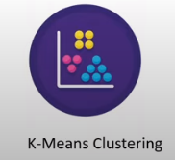
Work Flow

Slide 7
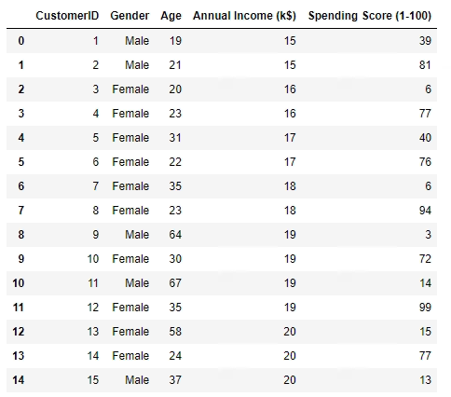
Analysing Data
Printing first 15 row of Customer Data:-

Slide 8
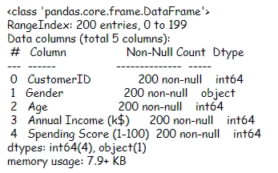
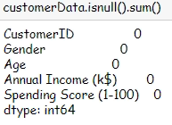
Data Preprocessing
Getting information about null values of data:-
Getting Sum of null values of data:-

Slide 9
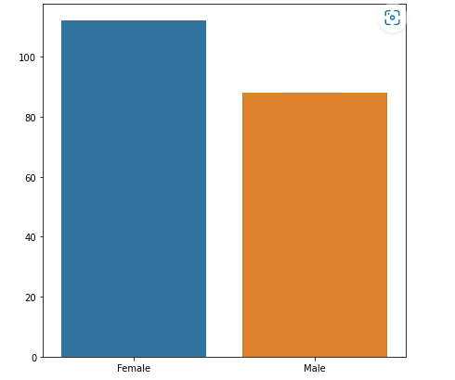
Visualizing Data Set
Bar Plot (Genders vs No of Customers):-

Slide 10
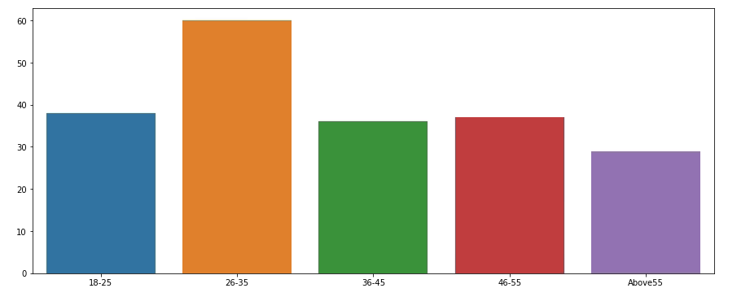
Visualizing Data Set
Bar Plot (Age vs No of Customers):-

Slide 11
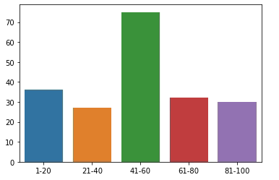
Visualizing Data Set
Bar Plot (Spending Score vs No of Customers):-

Slide 12
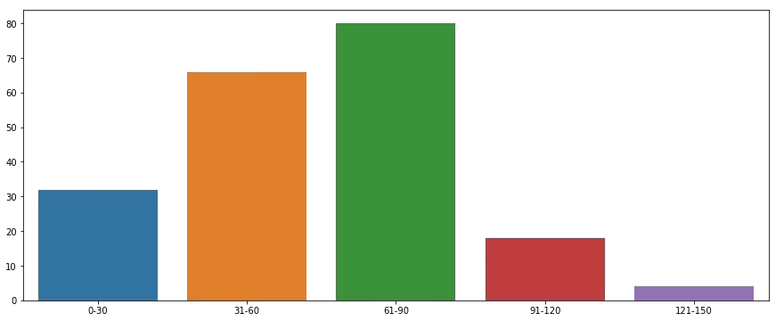
Visualizing Data Set
Bar Plot (Annual Income vs No of Customers):-

Slide 13
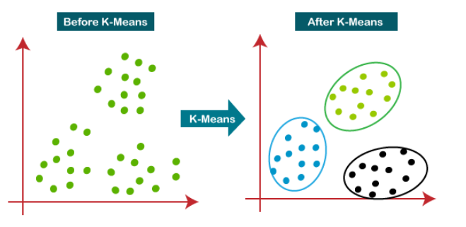
K Means Clustering Model
K-Means Clustering is an Unsupervised Learning Algorithm, which groups the unlabeled dataset into different clusters with simialiarily.

Slide 14
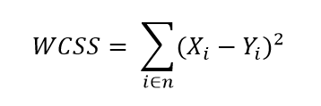
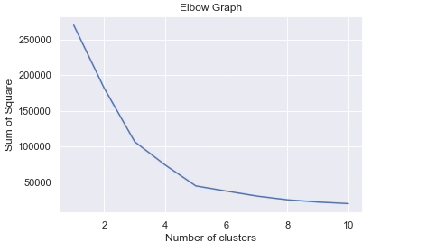
K Means Clustering Model
Using ELBOW method to find no of clusters:-

Slide 15
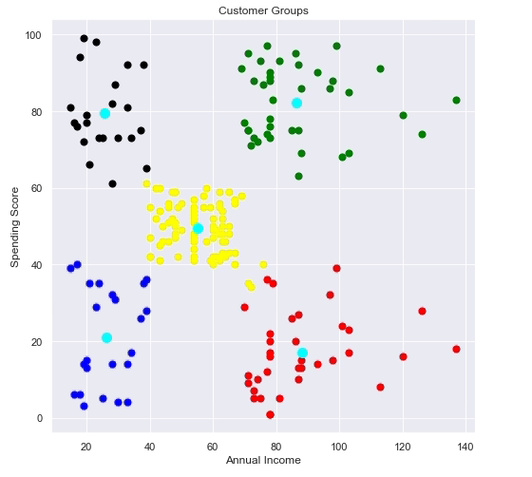
Visualizing the Clusters
Scatter plot of Data After Clustering customer into the groups:-

Slide 16
Thank You

